Slide 1


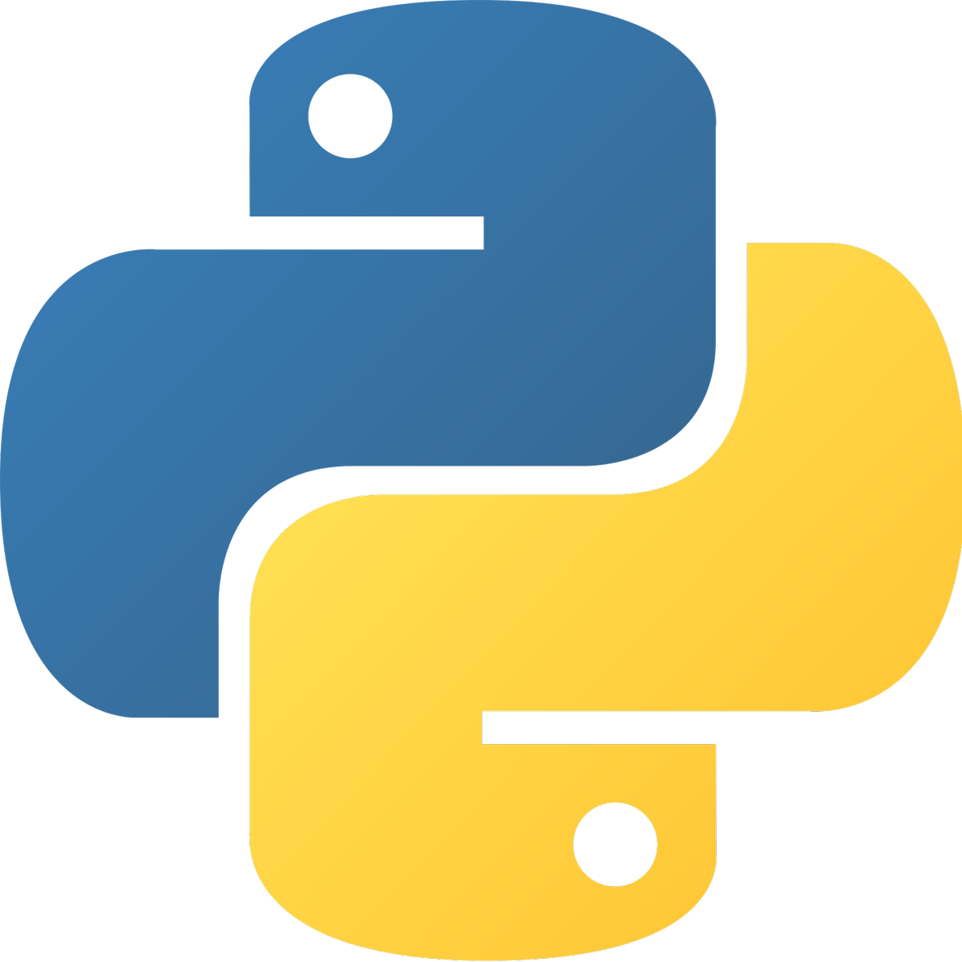

21AIE213 ROS & RS
TERM PROJECT

Slide 2
Team Members
Batch – A
Group – 1
Aman Sirohi [CB.EN.U4AIE21003]
R Sriviswa [CB.EN.U4AIE21046]
21AIE213 ROS & RS
Rakhil ML [CB.EN.U4AIE21048]
Vikhyat Bansal [CB.EN.U4AIE21076]

Slide 3
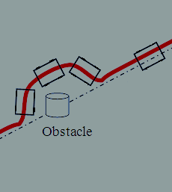
Auto Emptor : Your Own Shop Dog
Novelty:
Sitting at the Core of our Project is the concept of Obstacle Avoidance. It is just the foundation.
We are trying to make our bot roam around in a Maze (a shopping mart in our case) using the existing concept but then it is also facilitating the purchase. Our bot will go to the billing counter and scan the QR Code present at the Desk and return the result at the Result Window (integrated with the Camera Plugin) at our Desktop so that we can buy the products that we need and complete the payment, all while sitting at the comfort of our home.

Slide 4
Mobile Robot
Our Robot is a simple yet is of advanced kind where it is having a LIDAR sensor and Camera Module on it.
LIDAR is being used for the purpose of detecting the obstacles and then post detection avoiding them whereas Camera Module will look for the QR code all over the place and when found will display the QR image on the OPEN CV window and will also show the decoded text of the QR.

Slide 5
Obstacle Avoidance - Spawning
We are using Gazebo integrated with ROS2 (Humble Hawksbill Version) for the simulation of our model.
The core concept behind the locomotion of our Bot is the principle of Obstacle Avoidance. Now, there are plenty of resources available to create a simple bot which revolves around an obstacle following the same concept. So we are using those tutorials and making our Robot capable enough to roam around in the Maze (Shopping Mart) without colliding with the Showcase Racks.
We are using a separate package for the spawning purpose, which will spawn the robot on the map

Slide 6
Obstacle Avoidance - Movement
Our bot will be having a LIDAR sensor attached onto it which will be responsible for the obstacle avoidance part.
Then we have created a package for the sake of movement while avoiding the obstacles which contains two python files namely controller and estimator where one manages the movements and other deals with the coordinates on map respectively.
Note:
We are working on the assumption that the Bot has already picked the desired product (if time and resource permits we will add that feature as well).

Slide 7
Working of the camera
A node is being created by the class camera for purpose of reading the QR.
The node is going to take the data coming from the camera module by the help of subscription and that data will be passed on to the OpenCV for further preprocessing and for the displaying purpose.

Slide 8
Reading the QR
We are importing one of the well known python library out there namely OpenCV and Pyzbar for our purpose.
We are using CV_Bridge which is used for the purpose of bridging CV platform with ROS.
The camera module on the robot does the work of reading the QR in form of image and after some preprocessing steps, it displays the image on CV window.

Slide 9
Decoded message
Here we are using our imported library of Pyzbar for this purpose where the image is being decoded by the help of function decode provided by Pyzbar. The data after being decoded is displayed in form of text in terminal.

